Slide 1
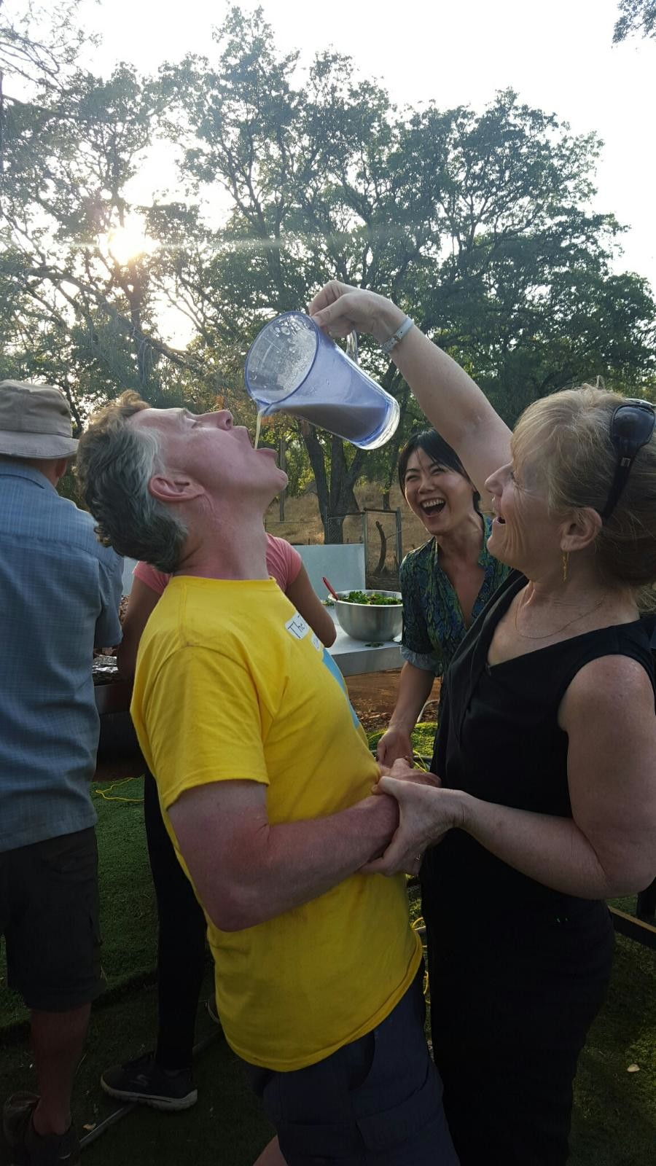
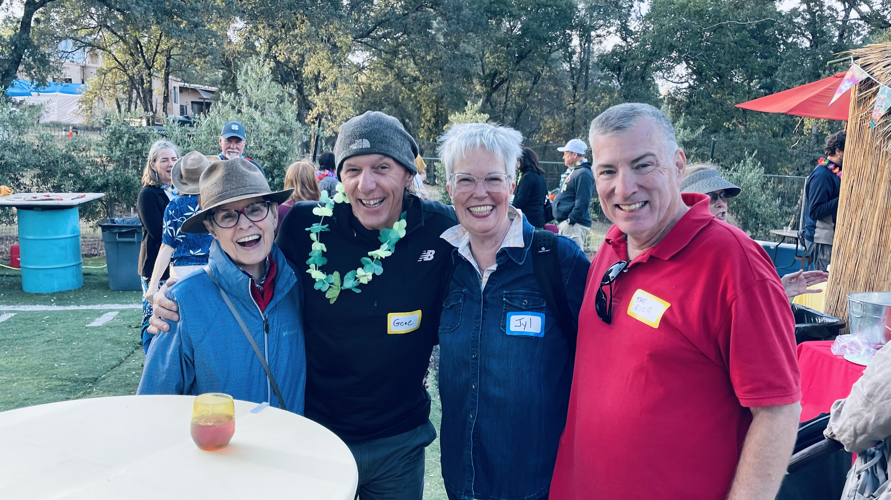

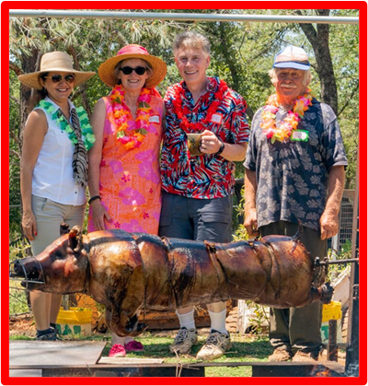
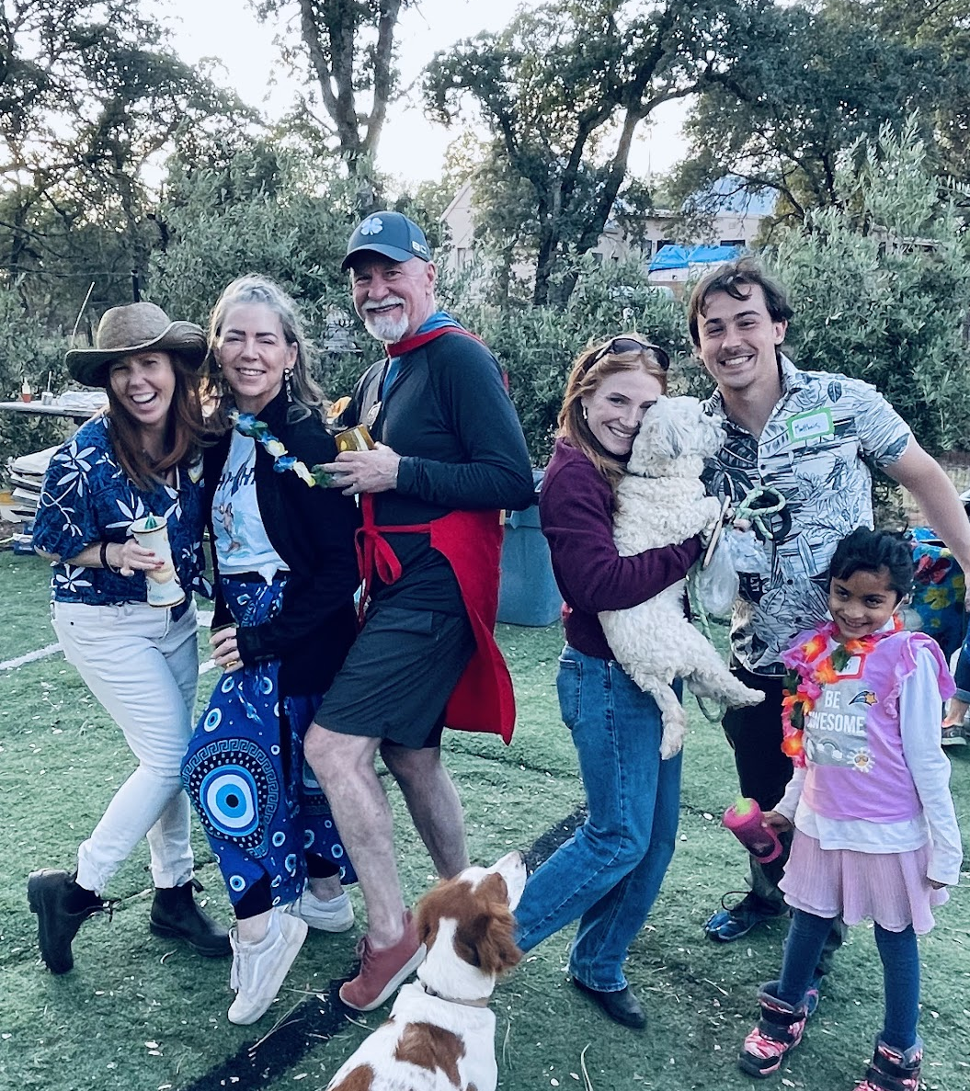
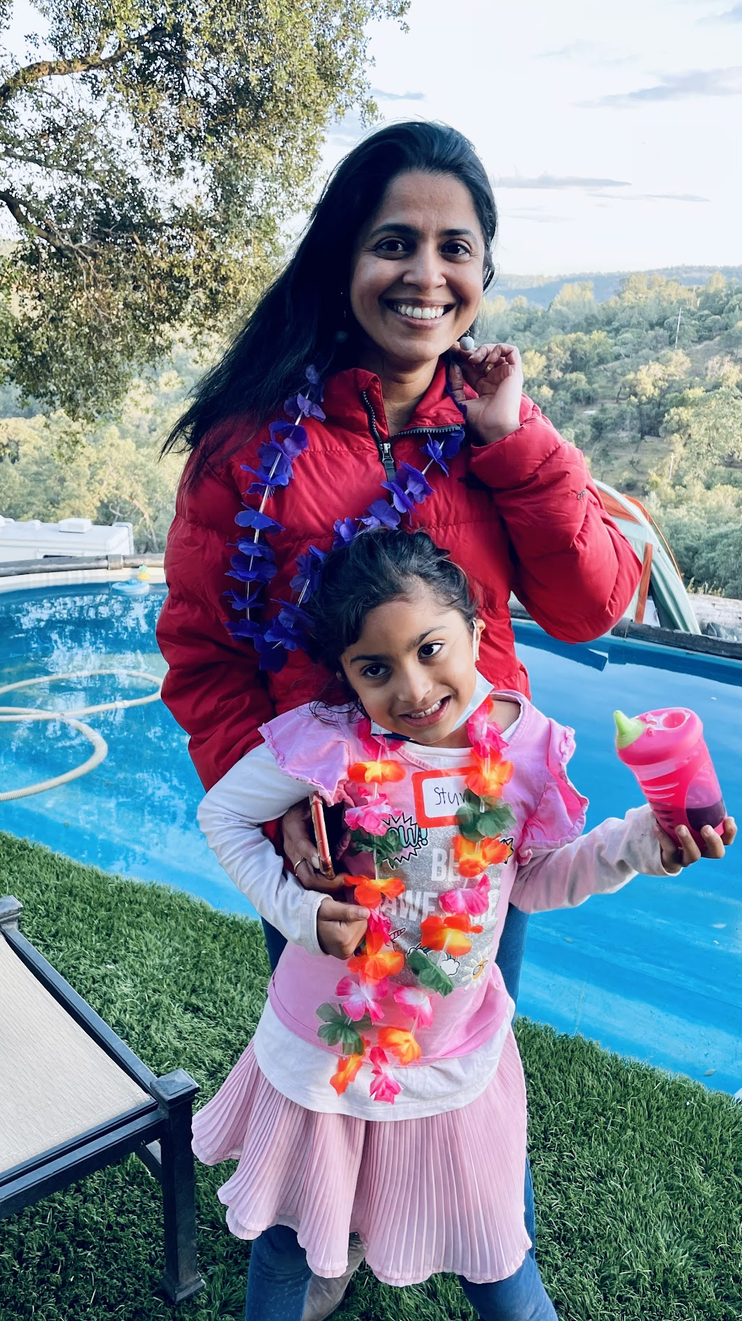
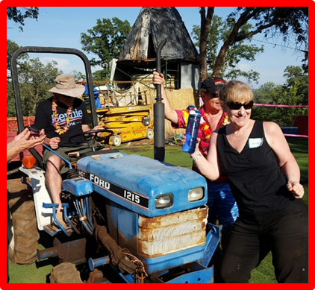
Finally, It’s Tiki Party time!
Memorial Day Weekend at the Tiki Ranch
Camping, Glamping, Tiki Hut, or Hotel under the starry sky!!!
7121 Ryan Ranch Road, El Dorado Hills, CA, 95762
Memorial Day Weekend (May 24th-27th)
Pig Roast on Sunday but feel free to arrive on Saturday and leave on Monday

